Slide 1
Yeast neg

Slide 2
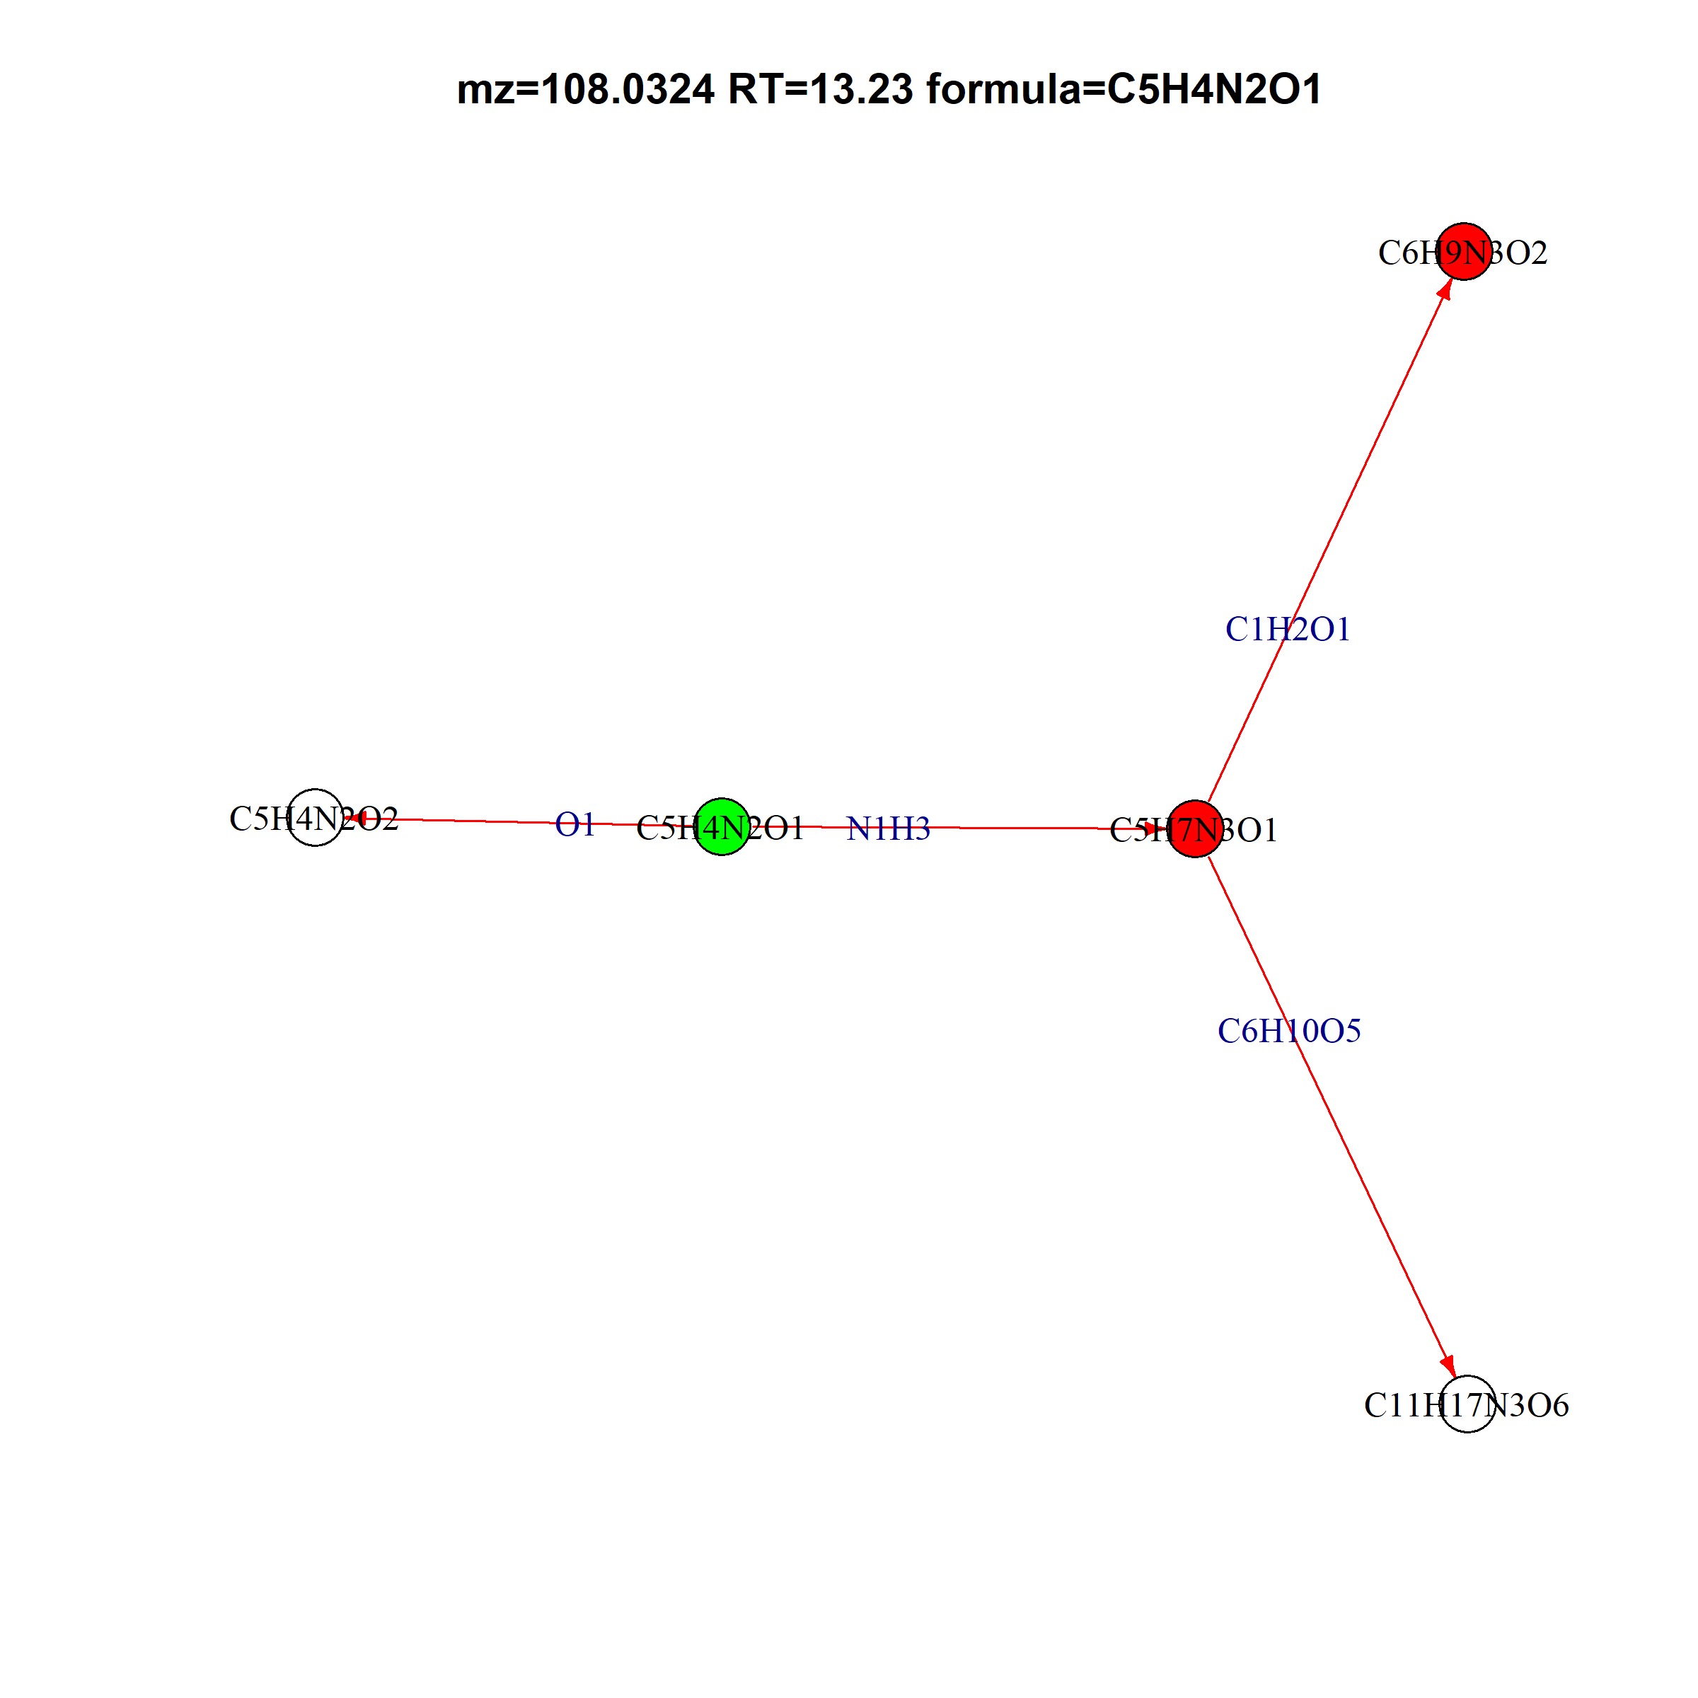
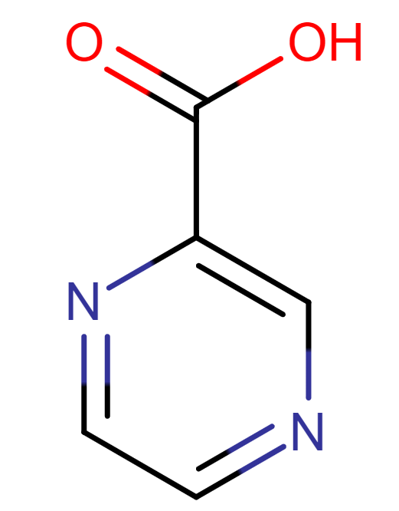
L-Histidine
Maybe nucleobase related, or histidine
Methylcytosine
108.0324 13.23304 C5H4N2O1
N-Ribosylhistidine

Slide 3
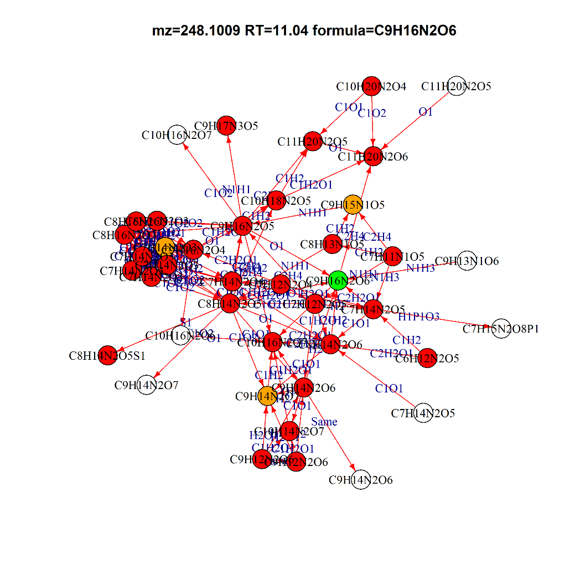
C9H16N2O6 Glutamyl-Threonine
Already in HMDB
C9H14N2O6 | 5,6-Dihydrouridine; L-alpha-Aspartyl-L-hydroxyproline; Aspartyl-Hydroxyproline
C9H13N1O6 | N2-Succinyl-L-glutamic acid 5-semialdehyde
C7H15N2O8P1 | Glycineamideribotide
C10H16N2O6 | L-alpha-glutamyl-L-hydroxyproline; Glutamyl-Hydroxyproline; Hydroxyprolyl-Glutamate; Oxypinnatanine
C9H14N2O7 | L-beta-aspartyl-L-glutamic acid; Aspartyl-Glutamate; Glutamylaspartic acid; gamma-Glutamylaspartic acid
C11H20N2O5 | gamma-Glutamylisoleucine; gamma-Glutamylleucine; Glutamylisoleucine; Glutamylleucine; Isoleucyl-Glutamate; Leucyl-Glutamate
C10H16N2O7 | gamma-Glutamylglutamic acid; Glutamylglutamic acid; Thymidine glycol
C7H14N2O5 | Serylthreonine; Threoninyl-Serine

Slide 4
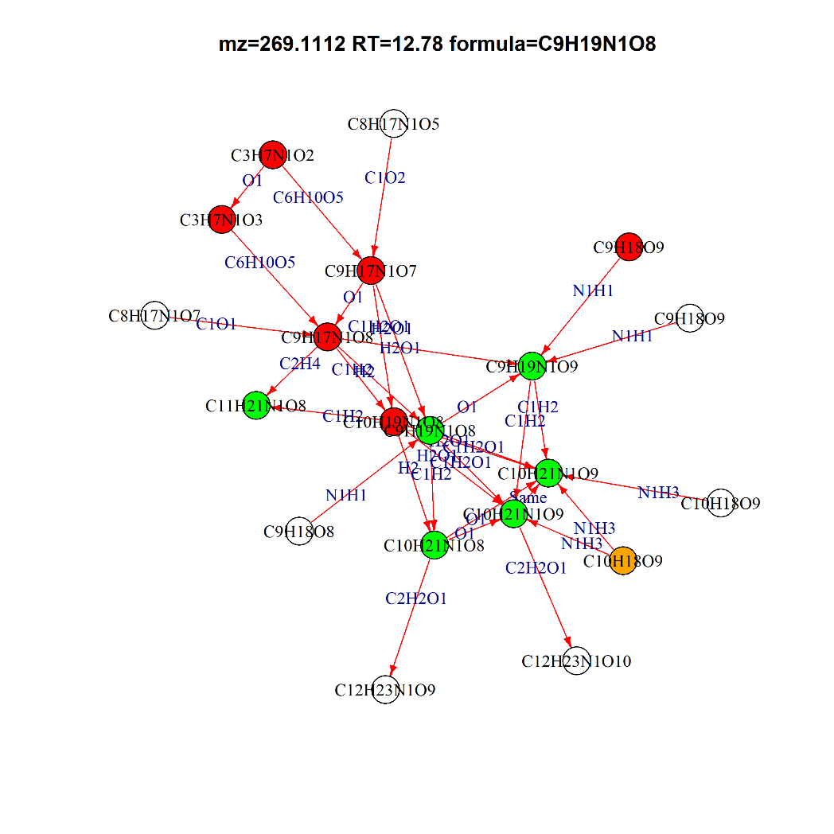
269.1112 | 12.78078 | C9H19N1O8
283.1267 | 11.82387 | C10H21N1O8 | GLC+C4H9NO2
285.1061 | 13.3723 | C9H19N1O9
295.1269 | 11.62258 | C11H21N1O8 | GLC+C5H9NO2
299.1216 | 13.31301 | C10H21N1O9
299.1217 | 12.91178 | C10H21N1O9
C12H23N1O10 | Lactosamine; 6-(alpha-D-Glucosaminyl)-1D-myo-inositol
C9H18O8 | Galactosylglycerol; (2R)-1-O-beta-D-Galactopyranosylglycerol
C8H17N1O5 | Miglitol
C10H18O9 | Arabinopyranobiose; Xylobiose; Arabinofuranobiose; 3-O-alpha-L-Arabinopyranosyl-L-arabinose; 5-O-a-L-Arabinofuranosyl-L-arabinose; 2-O-b-D-Xylopyranosyl-L-arabinose; 5-O-beta-D-Xylopyranosyl-L-arabinose
C9H18O9 | D-erythro-L-galacto-Nonulose
C8H17N1O7 | N-Gluconyl ethanolamine
C12H23N1O9 | 2-O-alpha-D-Galactopyranosyl-1-deoxynojirimycin; Glucopyranosylmoranoline

Slide 5
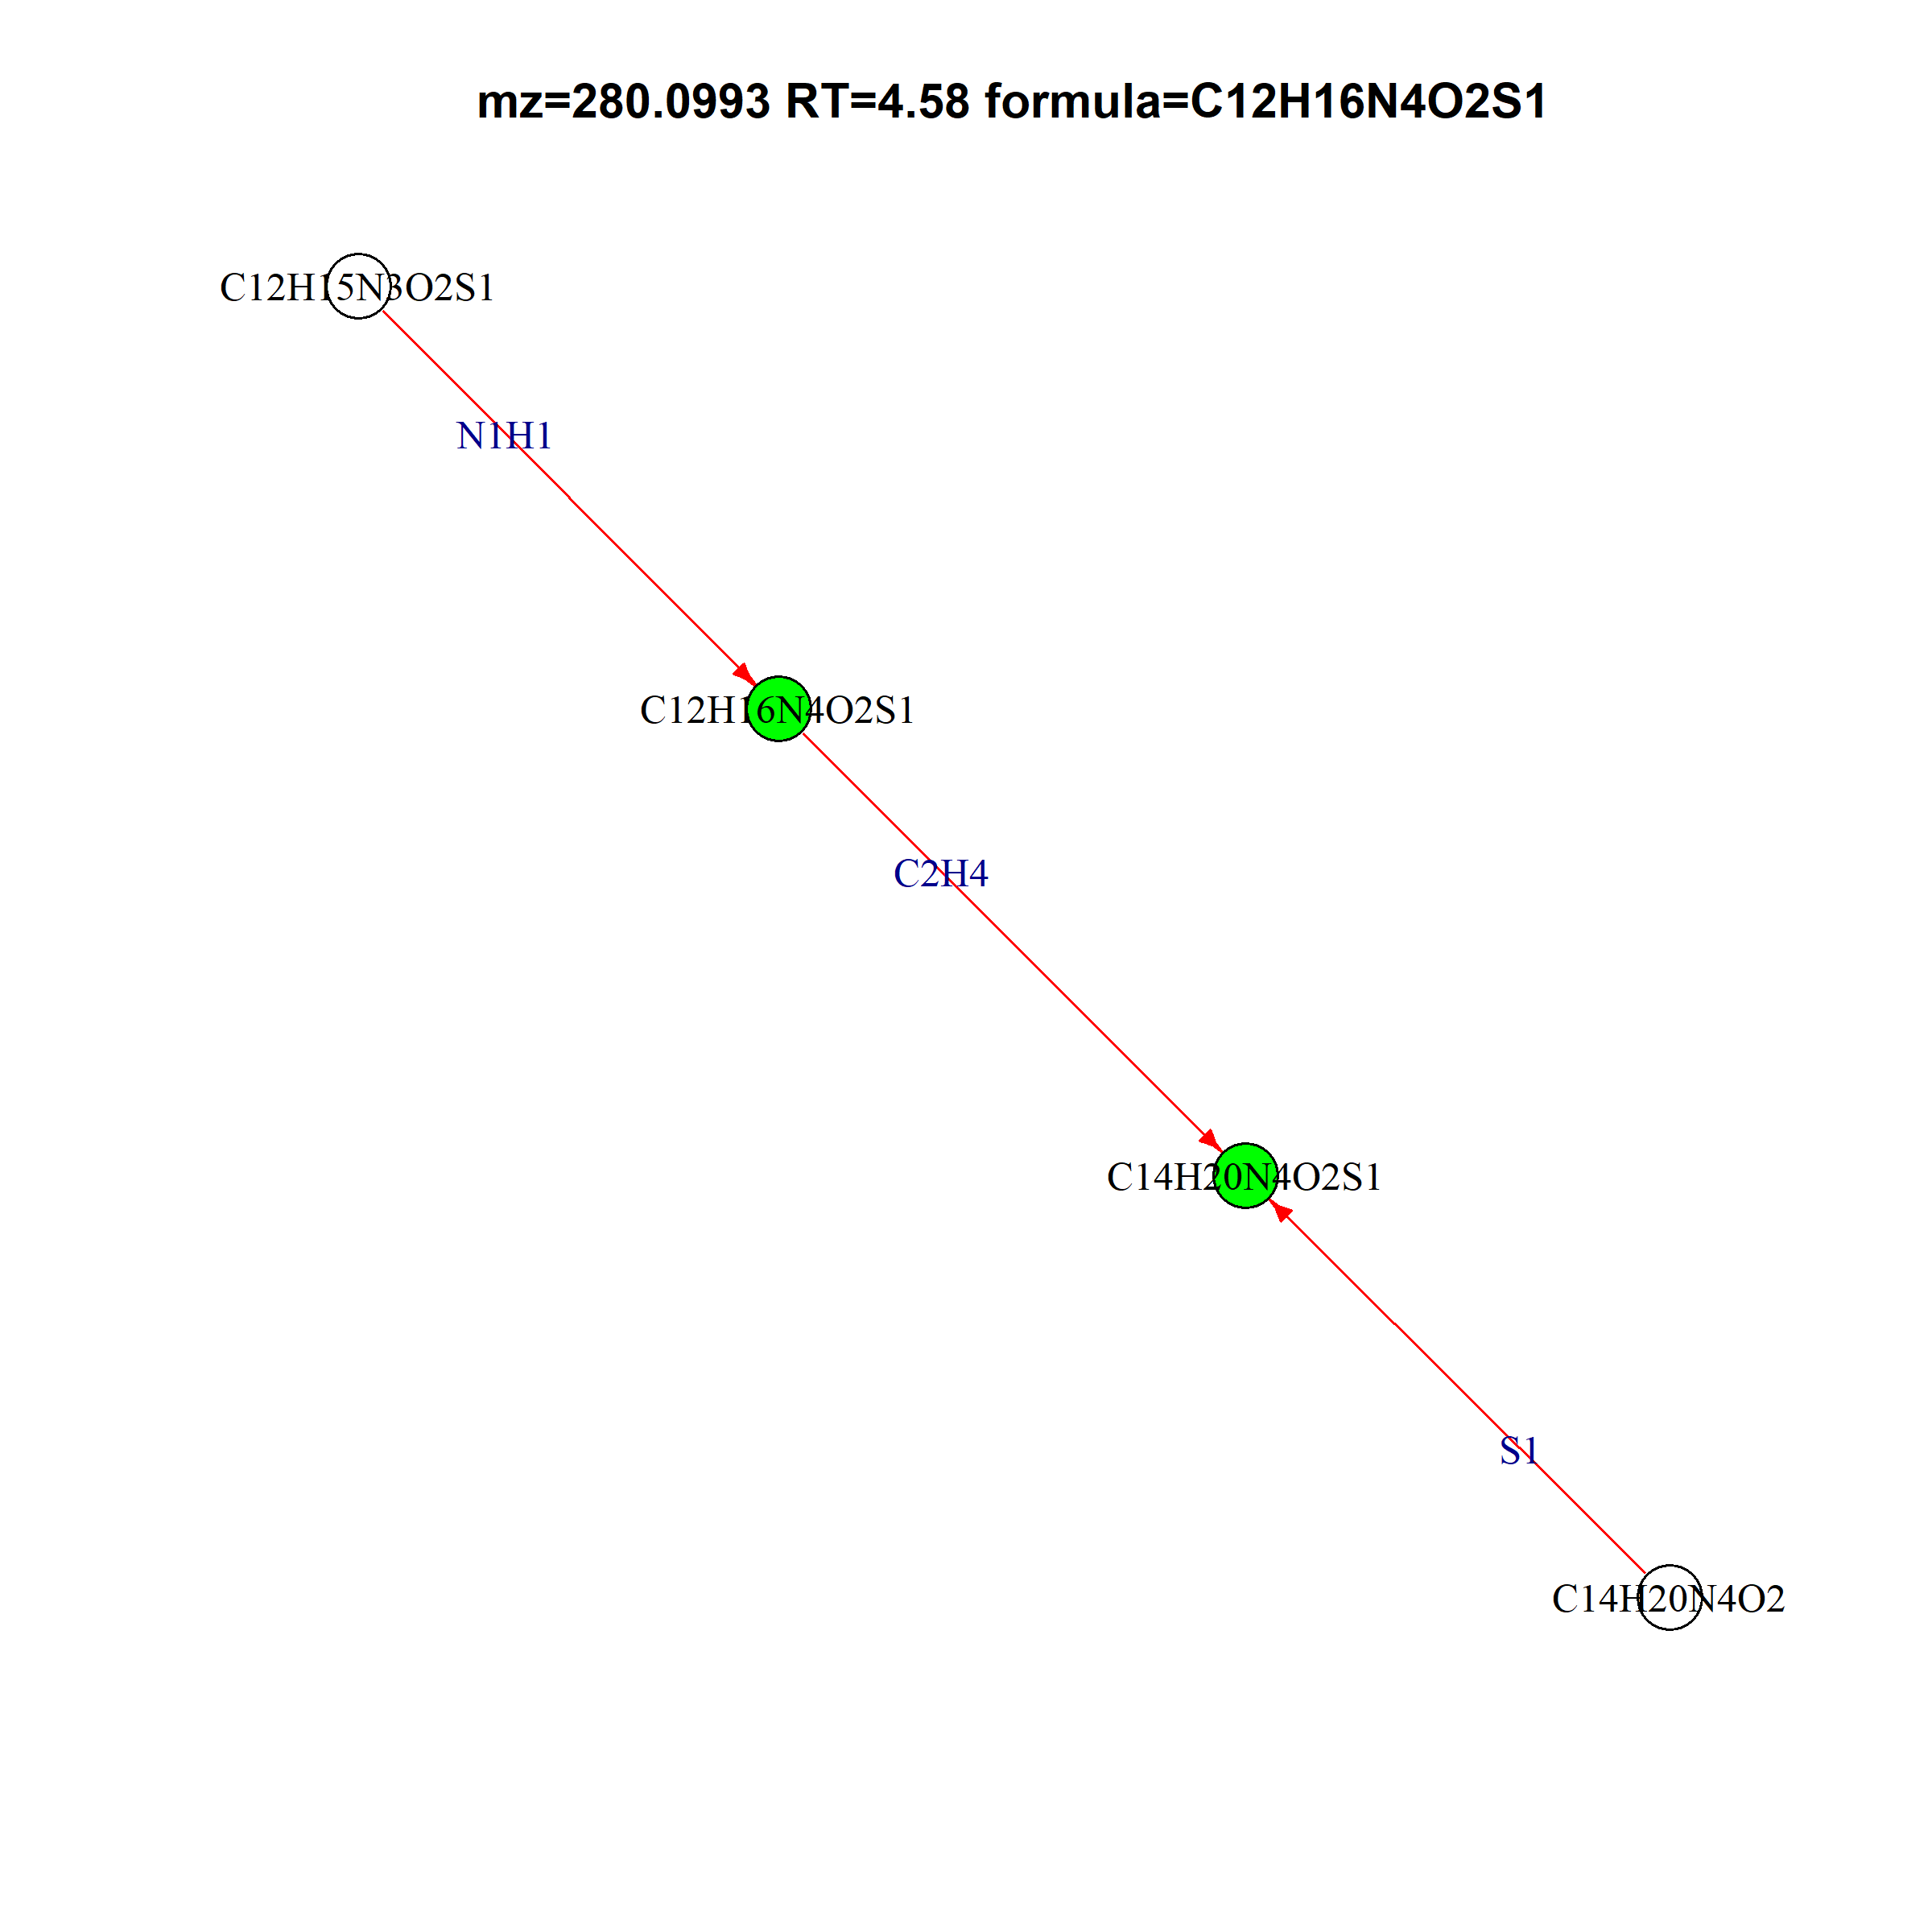
Thiamine
280.0993 | 4.584478 | C12H16N4O2S1
308.1308 | 10.85653 | C14H20N4O2S1

Slide 6
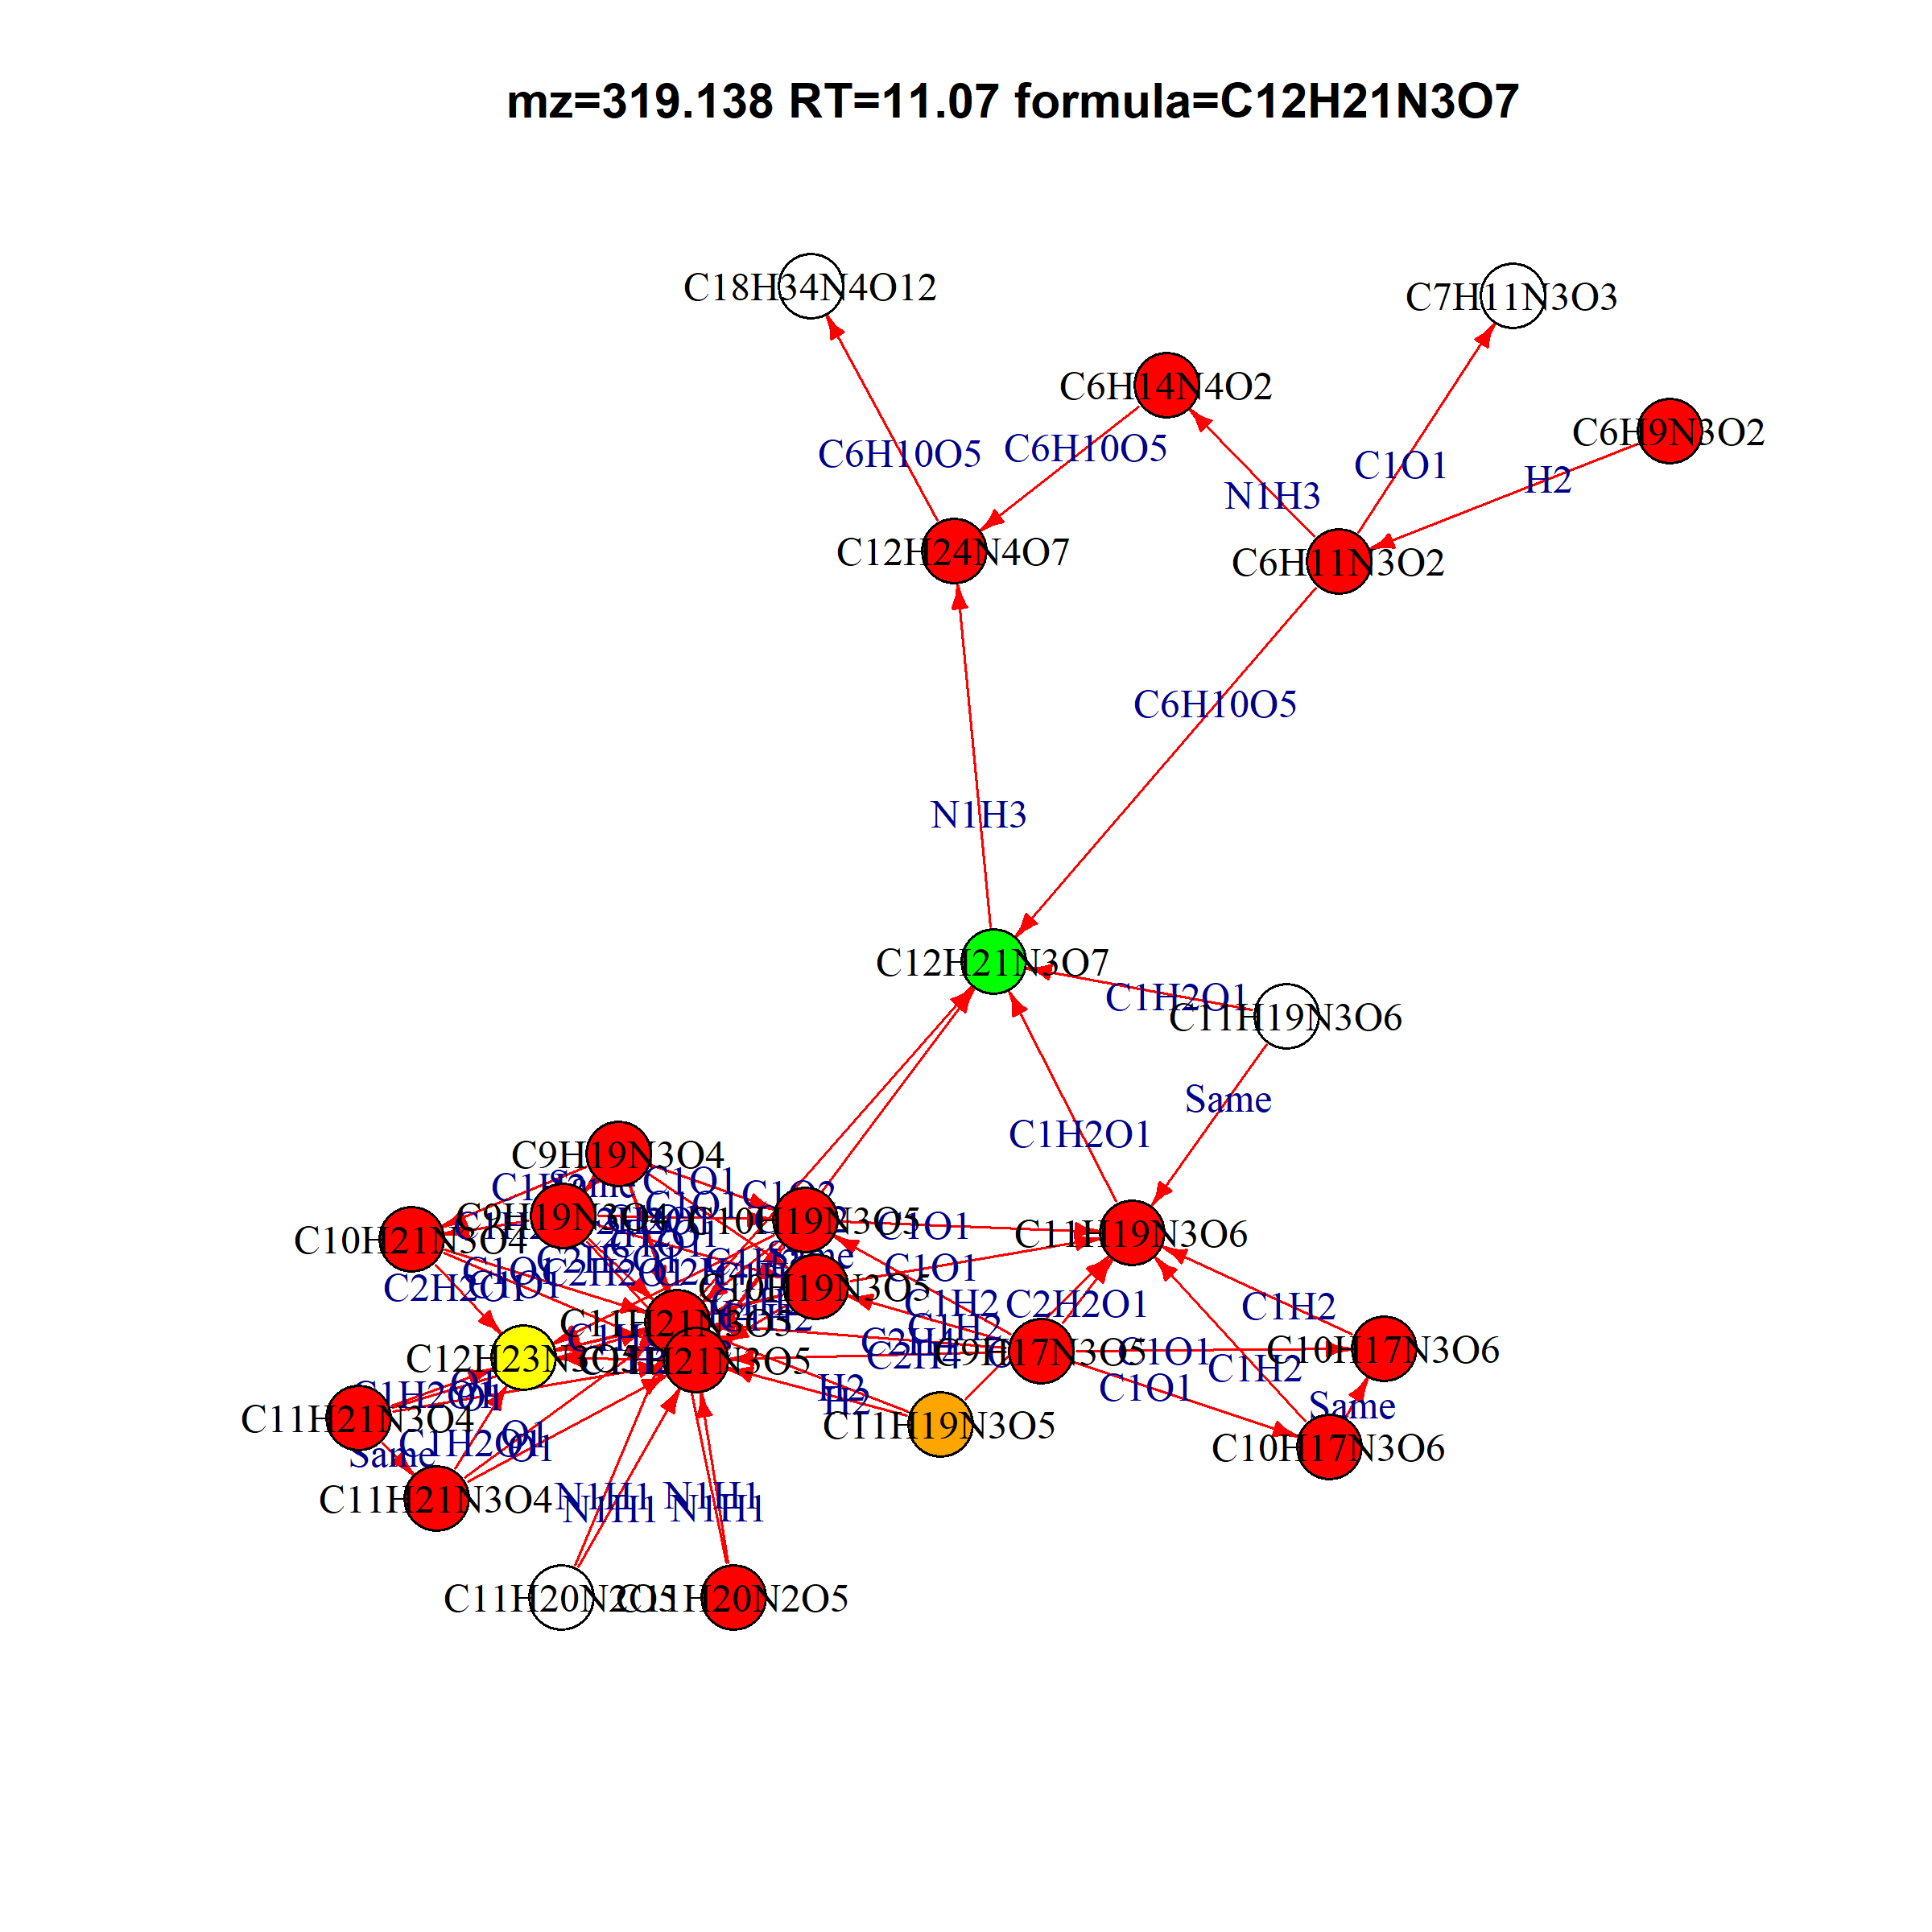
Likely tripeptide
319.138 11.06578 C12H21N3O7
Ophthalmic acid | C11H19N3O6
gamma-Glutamylisoleucine; gamma-Glutamylleucine; Glutamylisoleucine; Glutamylleucine; Isoleucyl-Glutamate; Leucyl-Glutamate | C11H20N2O5
(S)-N-(4,5-Dihydro-1-methyl-4-oxo-1H-imidazol-2-yl)alanine | C7H11N3O3
N2-Maltulosylarginine | C18H34N4O12

Slide 7
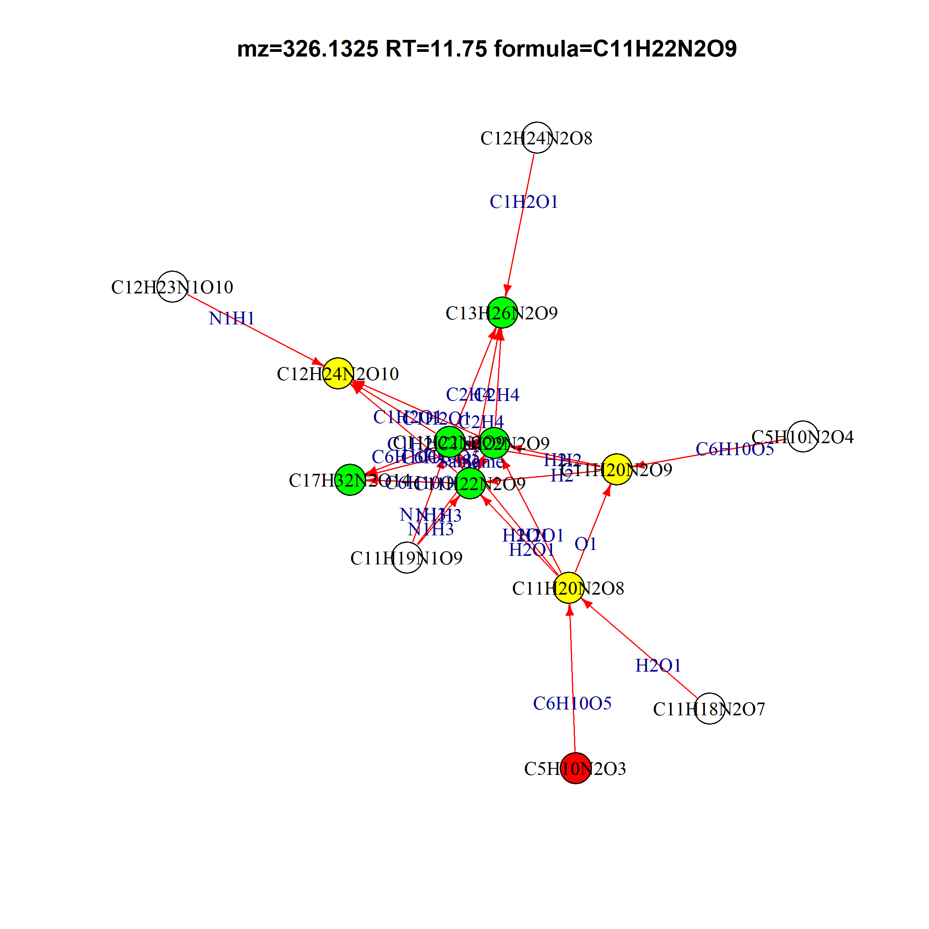
146.0690765 | 13.22636 | C5H10N2O3 | glutamine | red
308.1219765 | 13.35268 | C11H20N2O8 |  | yellow
324.1168765 | 13.27995 | C11H20N2O9 |  | yellow
326.1324765 | 11.75445 | C11H22N2O9 | GLC+GLUTAMINE | green
326.1325765 | 11.56298 | C11H22N2O9 | GLC+GLUTAMINE | green
326.1325765 | 13.26636 | C11H22N2O9 | GLC+GLUTAMINE | green
354.1638765 | 11.64453 | C13H26N2O9 | GLC+Acetyl-ornithine | green
356.1430765 | 11.36078 | C12H24N2O10 | GLC+C6H12N2O4 | yellow
488.1852765 | 13.24291 | C17H32N2O14 | ？ | green
C6H12N2O4

Slide 8
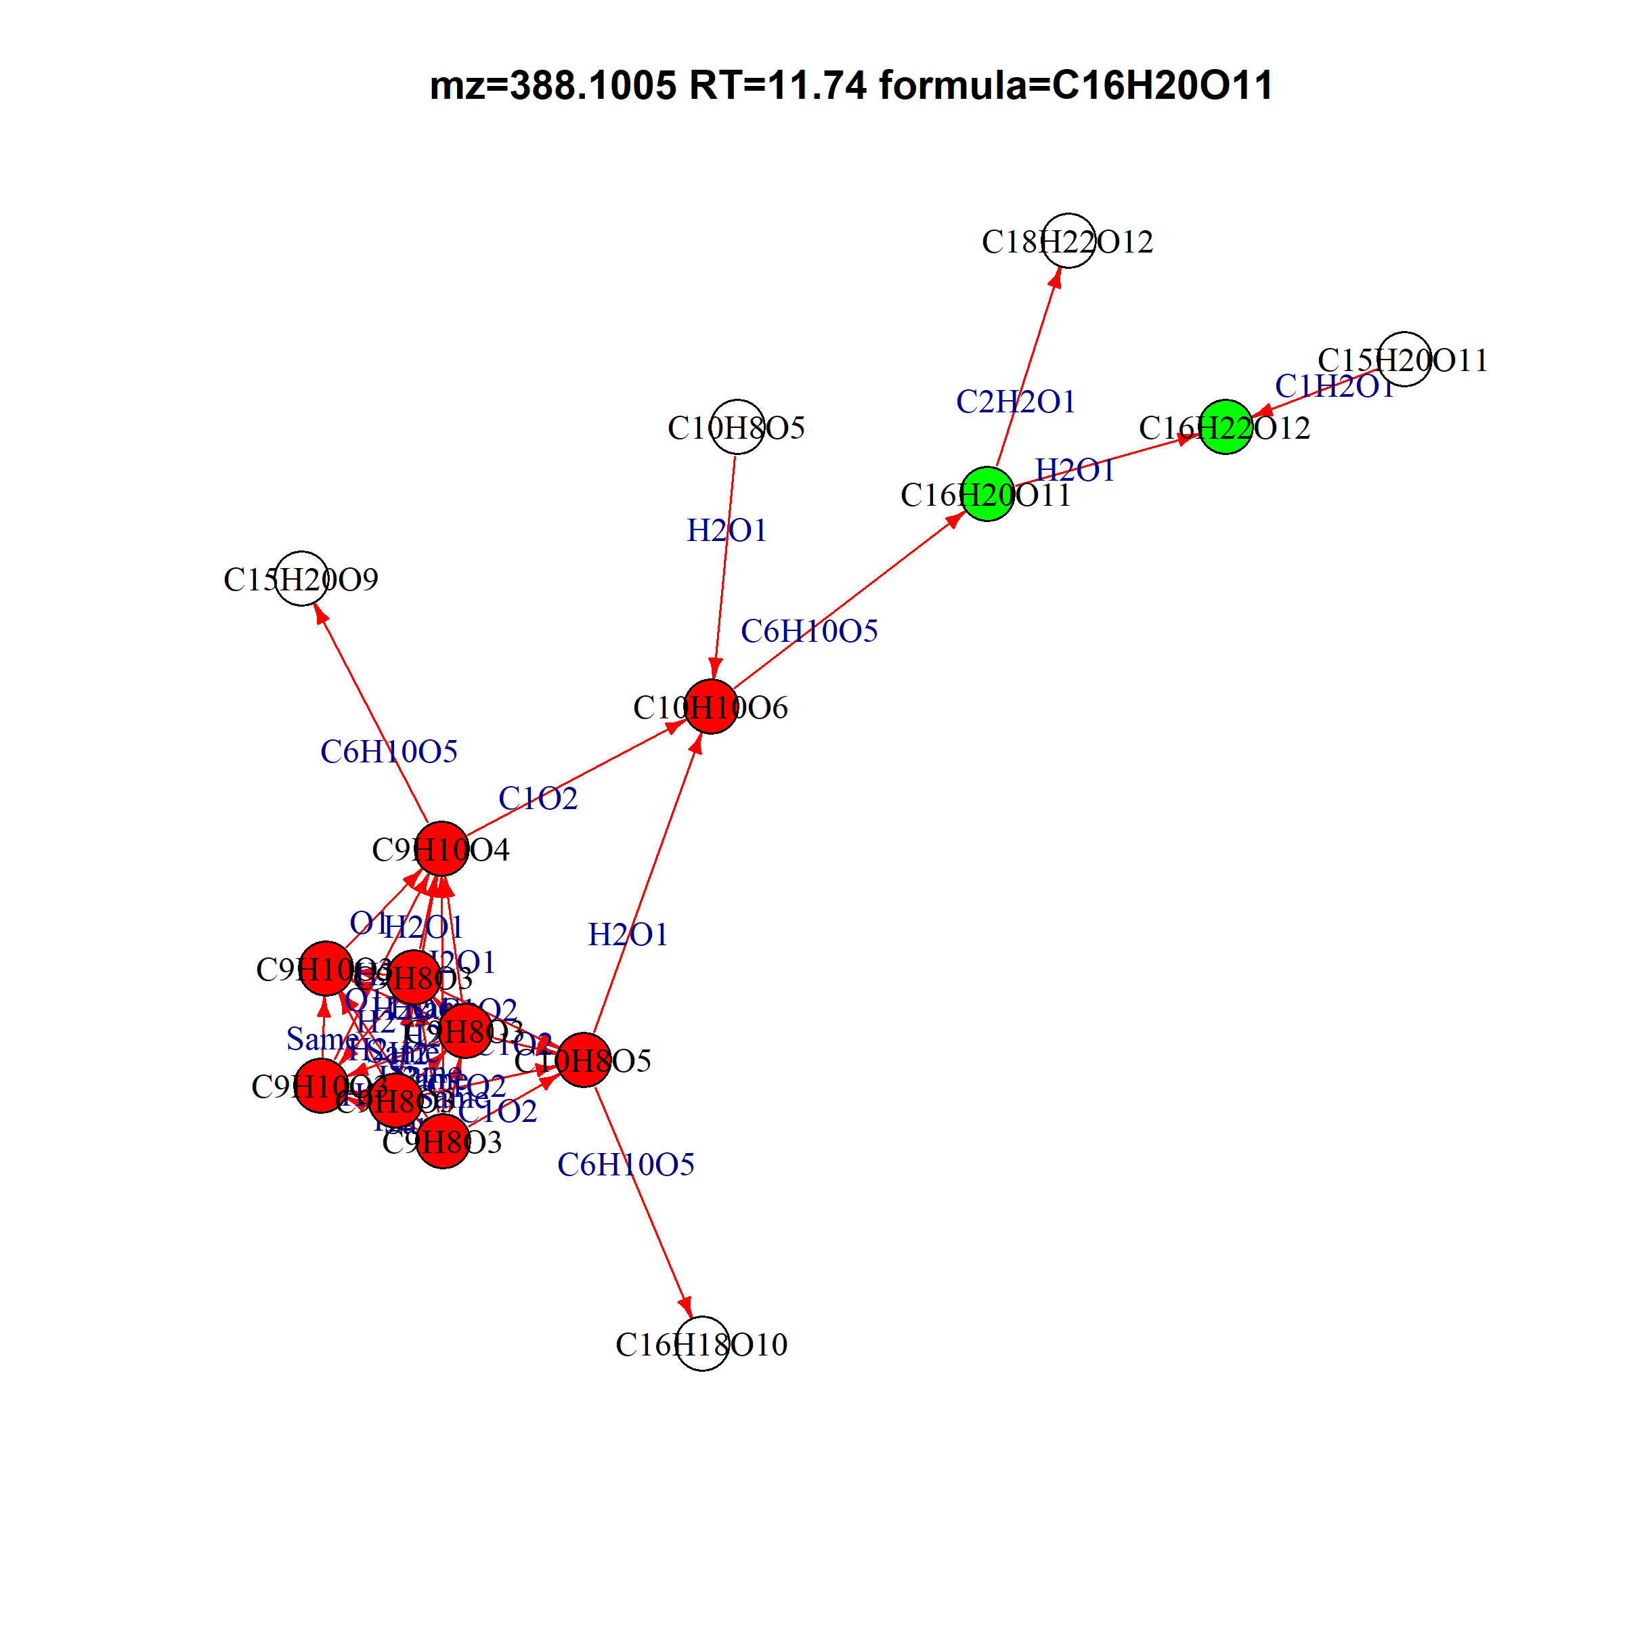
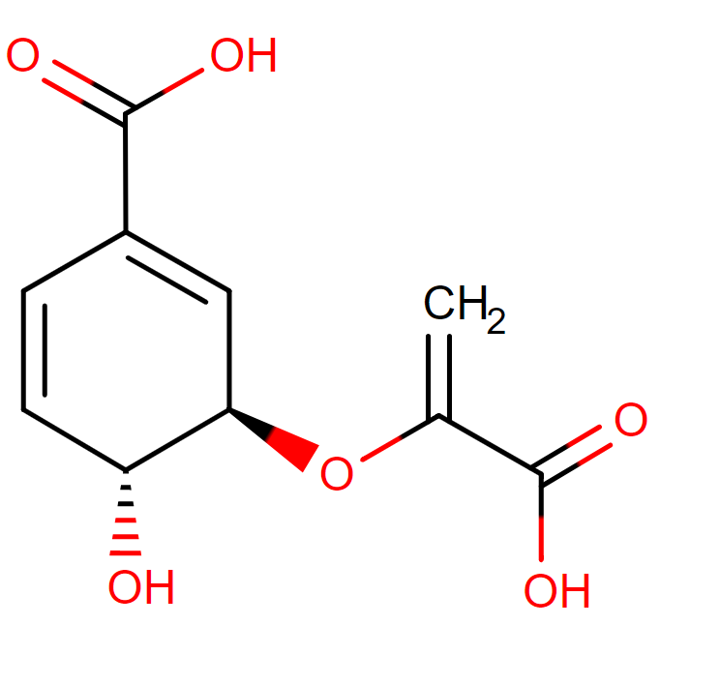
Likely glucose adducts
388.1004765 | 11.73557 | C16H20O11
406.1111765 | 11.71671 | C16H22O12

